Slide 1



From C# to F#
@marlonvilorio

Slide 2
- Introducing F# to your org
Overview
- C#/F# Interop (Demo)

Slide 3




How do you introduce F# to your org?
Start with your team
Hour of Learning
Experiment
Address Concerns

Slide 4



How do you get F# into your org?
Address Concerns
Future Opportunities
Being a Noob
Fear of FP
Better Dev
Not All Or Nothing
- Easy to Learn

Slide 5
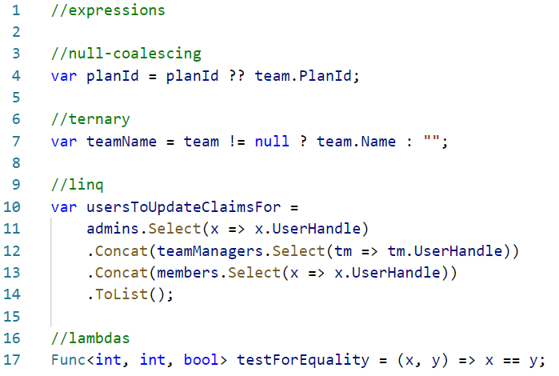
FP in C#

Slide 6
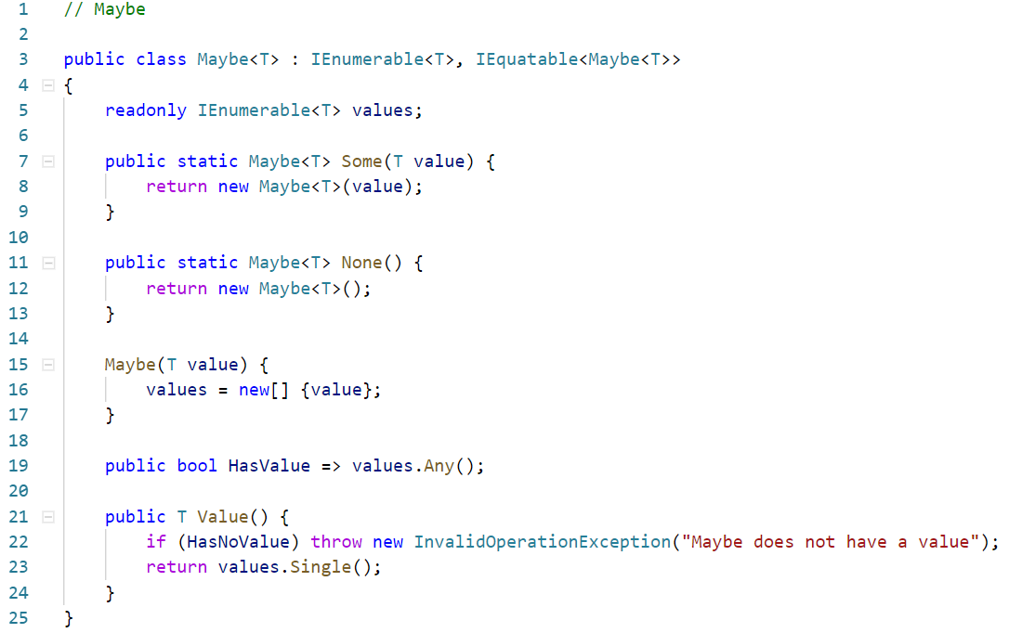
FP in C#

Slide 7
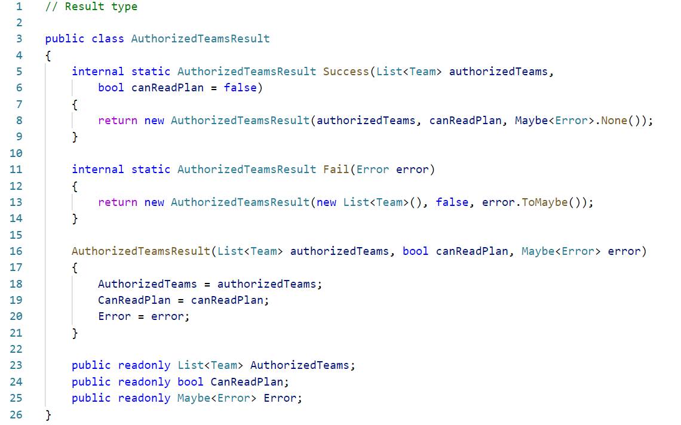
FP in C#

Slide 8


How do you get F# into your org?
Convince your boss
Show Advantages
Address Concerns

Slide 9



How do you get F# into your org?
Show Advantages
.NET Language
No more FP in C#
Powerful Type System

Slide 10



How do you get F# into your org?
Address Concerns
Costs
Time
Hiring
- Minimal
Experiment Helps
Gradual Change
- Survey

Slide 11
How do you bring your team up to speed?
Books

Slide 12


Where do you start?
Domain Types
Edges
Adhocs
Notes:
Domain Types are an easy win in order to take advantage of F#’s power type system in C# (it might not require manager approval also)
DU’s, Records, Pattern Matching, etc
Edges you can start at a Repository work yourself up
Its what we did
Adhoc Processes, these are usually random applications that you have lying around to do random things that you could easily convert over to F# without affecting the rest of the system.

Slide 13
DEMO

Slide 14




Demo
API
Repo

Slide 15

Demo Summary
F# Types
Regular/Static C# Classes
F# Modules
Static C# Class
FuncConvert
Convert to FSharpFunc
Bridge Code
Maintain your code pure
Extensions
Take advantage of F#
Notes:
Address things such as these head on… don’t shy away from them
Show how fast it has taken to bring your team up to speak,
Show that from a new tech stand point it will cost the company no money
From a productivity stand point the returns will be greater
For hiring survey’s throughout the company and workshops would be a great way to show that there is interest

Slide 16

Demo Summary
CLI Mutable
For Serialization
Null to Option
Address in Bridge Code
Collections
Address in Bridge Code or Use IEnumerable
Notes:
Address things such as these head on… don’t shy away from them
Show how fast it has taken to bring your team up to speak,
Show that from a new tech stand point it will cost the company no money
From a productivity stand point the returns will be greater
For hiring survey’s throughout the company and workshops would be a great way to show that there is interest

Slide 17

Questions?
You can find me at:
Thank you!
@marlonvilorio
mavs0890
Notes:
So today I would like to focus on two things
First
I would like to tell you the story about how we were able to get F# approved at Pluralsight. My hope is that from our experience you can take at least a few things you can apply to your current job situation to help you in your journey to get F# approved.
After that I would like to spend the bulk of our time together showing you what its like to work in a mixed solution and showing you some things you can do to make interop in between C# and F# a little easier.
Again my hope is that you will be able to apply a few or a lot of the things that you learn today to help you on your F# journey.
****
So.. Lets jump into an overview of some the things I will be covering today. I will be talking about Introducing F# to your org. Once you have that approval… where do you even start? Where does it make more sense? And finally I would like to end with a little demo of what it is like to work on a mixed C#/ F# solution, and to give you some tips and tricks that have made it easier for us to work in a mixed codebase. Anyways lets jump right into it.

Slide 18
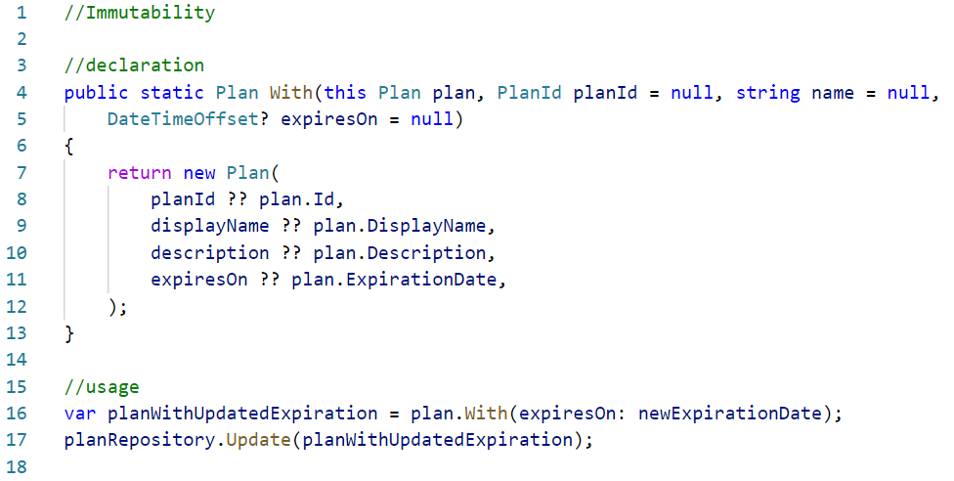
FP in C#
Notes:
Tell about me being the most resistant in the team to switch
Misunderstanding – Fear of the unknown – Help them realize that you might already be doing a lot of FP and might not even realize it

